Slide 1
Disk and File management
Chapter 12
Notes:
Hello, My name is 허완. Subjects of this presentation are 2, chapter12 and 13.
So, I will present chapter12 first, and have a 5min break and continue chapter13
Let me begin presentation
Chapter 12 is about Disk and File Management

Slide 2
Objects(목표)
How a DB system stores its data on physical devices (DB 시스템은 어떻게 데이터를 물리 장치에 저장하는가?)
How can File Manager of SimpleDB reads files on disk, and write pages to files on disk? (SimpleDB의 파일 매니저는 어떻게 파일을 디스크로부터 읽고 쓰는가?)
Notes:
Object of this chapter are is realizing those features.
Ppt 읽기

Slide 3
Contents
Disk Drives(디스크 구조)
How to access a disk drive(디스크 드라이브에 엑세스 하는 방법)
Improving Disk Access Time(엑세스 시간 향상)
Improving Disk Reliability(디스크 안정성 향상)
Interfaces for accessing disks
File-level Interface(파일 레벨 인터페이스)
Block-level Interface
Simple DB File Manager
Notes:
이해를 돕기 위해 우선 하드웨어에 대해 설명하고
OS가 디스크에 엑세스 하는 방법을 설명한 다음
SimpleDB 소스코드를 설명하겠습니다.

Slide 4
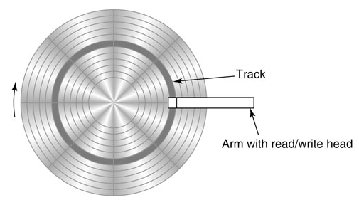
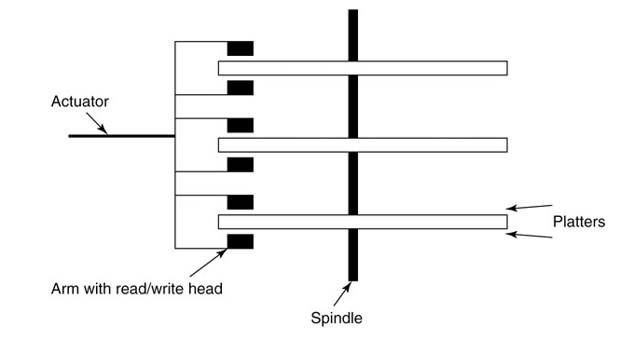
Disk Drive
Platter
contains thousand of tracks
Track
consists of a sequence of bytes
Sector
typically 4KB in recent
Actuator
Moves all arms
Arm
Moves heads to desired track
Disk head
read/write the bytes

Slide 5
Disk metrics
Capacity
How many bytes to write (bytes)
Rotation speed
rate at which there platters spin (rpm)
Transfer rate
speed at which bytes pass by the disk head (bytes/sec)
Average seek time
the time for the actuator to move the disk head
Notes:
We use

Slide 6
Accesing a Disk Drive – 3 states
It moves the disk head to the specified track(디스크 헤드가 특정 트랙으로 이동); seek time
It waits for the platter to rotate until the first desired byte is beneath the disk head. (원하는 첫번째 바이트가 헤드 밑에 올 때까지, 플래터의 회전을 대기); rotational time
As the platter continues to rotate, it reads each byte that appears under the disk head, until the last desired byte. (플래터가 회전하는 동안, 마지막 바이트를 읽을 때까지 헤드는 계속해서 각각의 바이트를 읽음); transfer time
Notes:
이것은 ~라 불립니다. This time is called the ~ time.

Slide 7
Improving Disk Access Time
Disk Caches
Bundled memory with disk
Typical size is 64MB
the disk drive reads a sector from disk, it saves the contents of that sector in its cache
Save rotational time
Cylinders
The set of tracks having the same track number is called a cylinder (conceptual)
Data with same track can improve access time.
Save seek time
Disk striping
Hide the smaller disks, Give it the illusion of a single large disk. (여러 개의 디스크를 하나의 디스크처럼 사용)
Using multiple disk drives to improve access time by using two independent actuators (같은 용량이라면 2개의 장치가 1개의 장치로 탐색할 때보다 빠름)
Notes:
Disk striping 보충 설명 필요할 듯

Slide 8
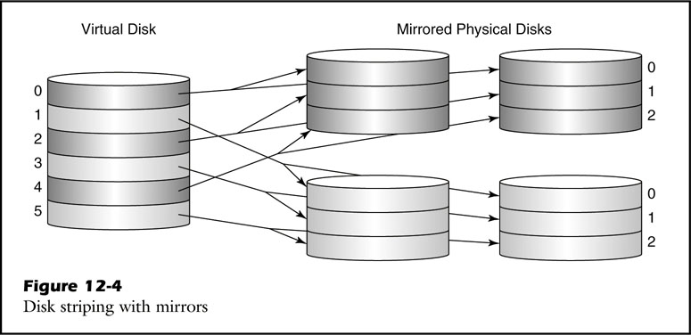
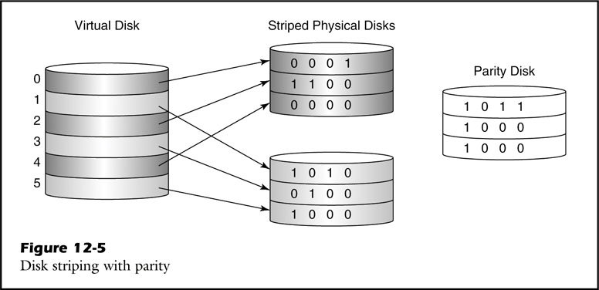
Improving Disk reliability
Disk Mirroring
Store the same data to another disk
Require 2 times disks
Storing Parity
Using parity bits to maintain data reliability
Cheaper than mirroring(Need additional a disk)
Notes:
If one disk faiel ~
There are two variants of parity bits: even parity bit and odd parity bit.

Slide 9
File-level Interface
Characteristics
Called file system
No notion of block
Named sequence of bytes
RandomFileAccess
JAVA class, typical API to the file system
Seek method of the class sets file pointer
The seek method performs two conversions:
It converts the specified byte position to a logical block reference.
It converts the logical block reference to a physical block reference.

Slide 10
File-level Interface
Conversion of the logical block reference to a physical block reference
Contiguous allocation
Also contiguous physical block
Indexed allocation
Data structure that has map with file and blocks.

Slide 11
Block-level Interface
Block
Smallest amount of data unit
Size of block is determined by the OS.
Page
block-sized area of main memory
Methods to access disk blocks(typically provided by OS)
readblock(n, p) reads the bytes at block n of the disk into page p of memory.
writeblock(n, p) writes the bytes in page p of memory to block n of the disk.
allocate(k, n) finds k contiguous unused blocks on disk, marks them as used, and returns the block number of the first one. The new blocks should be located as close to block n as possible.
deallocate(k, n) marks the k contiguous blocks starting with block n as unused.
Notes:
Difference between sector and block is that, sector don’t have the same size.

Slide 12
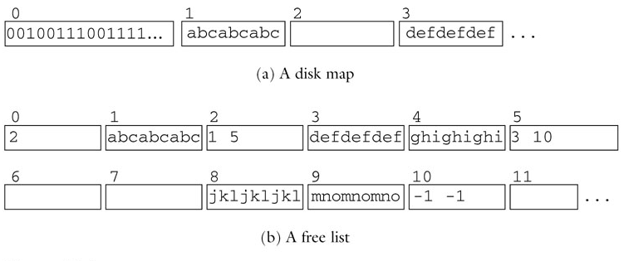
Tracking blocks
Disk Map
A Sequence of bits, one bit for each block on the disk.
1 is free, 0 is already allocated.
The disk map is stored on disk in the first several blocks.
Free List
Chain of chunks.
Chunk is contiguous sequence of unallocated blocks.
The first block of each chunk stores two values; length and next block number.
Disk Map
asb

Slide 13
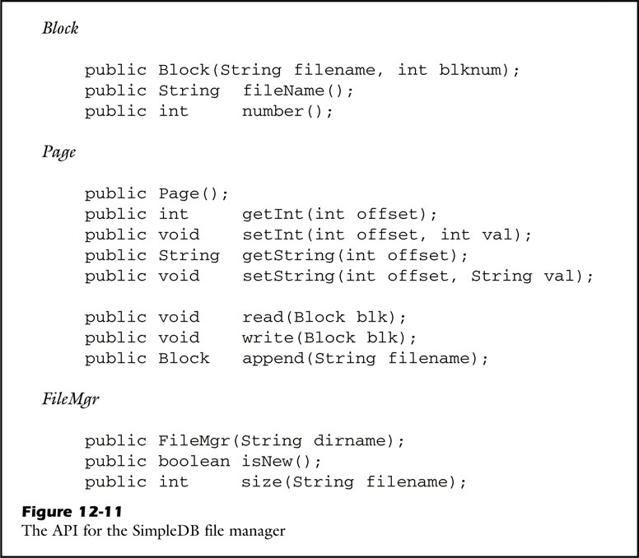
SimpleDB - Overview
// bytebuffer
// block to bytebuffer
// bytebuffer to block
// bytebuffer to new block of
specific file
// return number of blocks

Slide 14
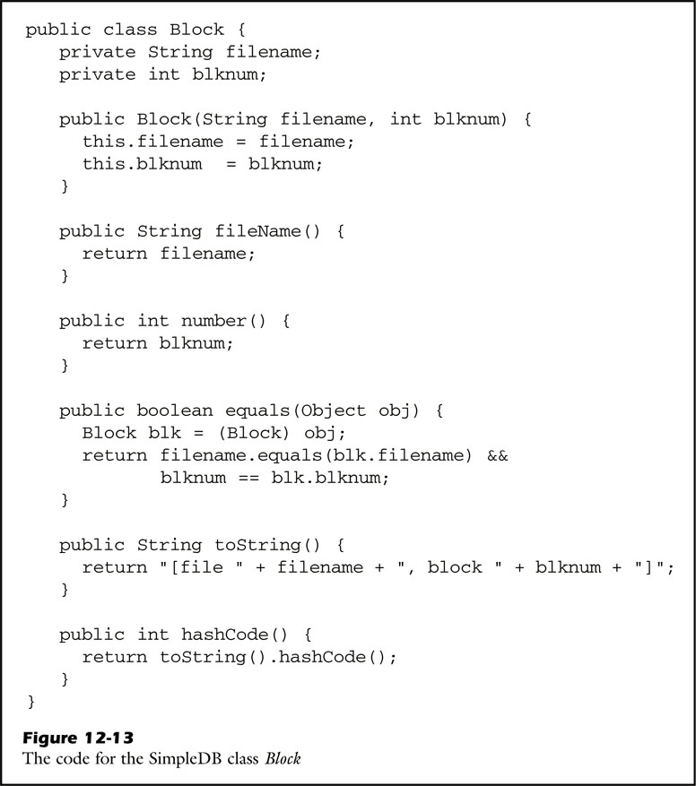
SimpleDB - Block
Block is consists of filename and blknum.
// Get filename of block
// Get blknum of block

Slide 15
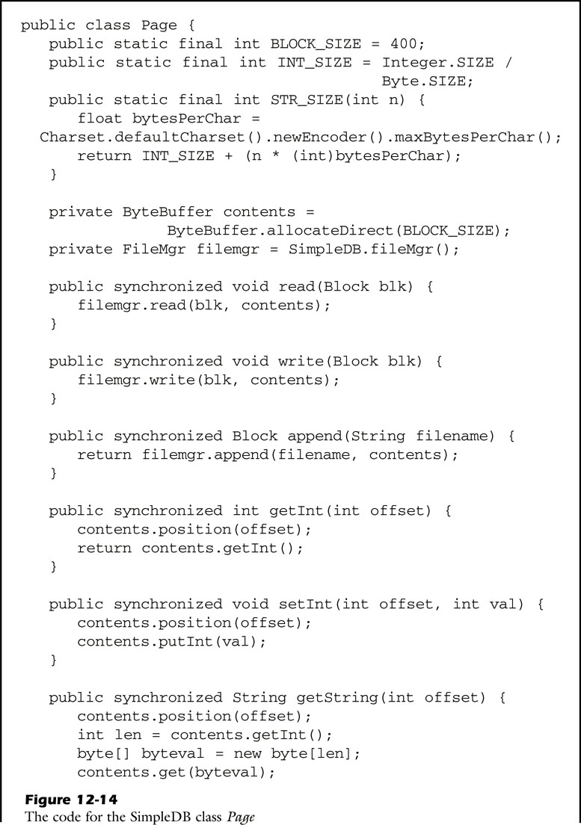
SimpleDB - Page
// block to bytebuffer
// bytebuffer to block
Because of Consistency
// bytebuffer to new block of
specific file

Slide 16
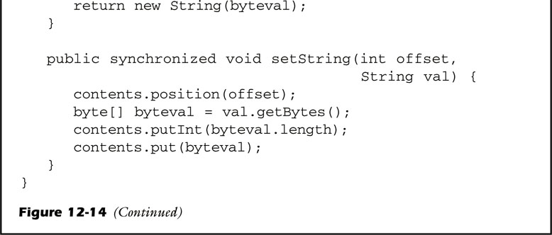
SimpleDB - Page

Slide 17
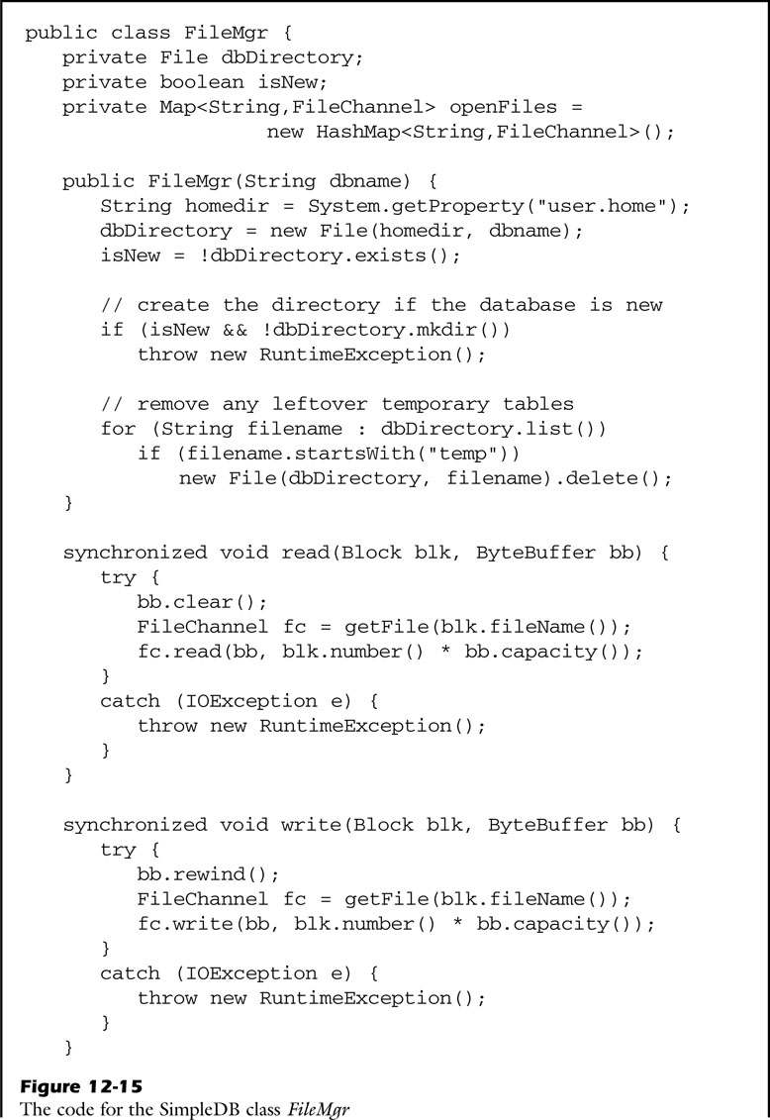
SimpleDB - FileMgr
// init with specific directory
// Check directory

Slide 18
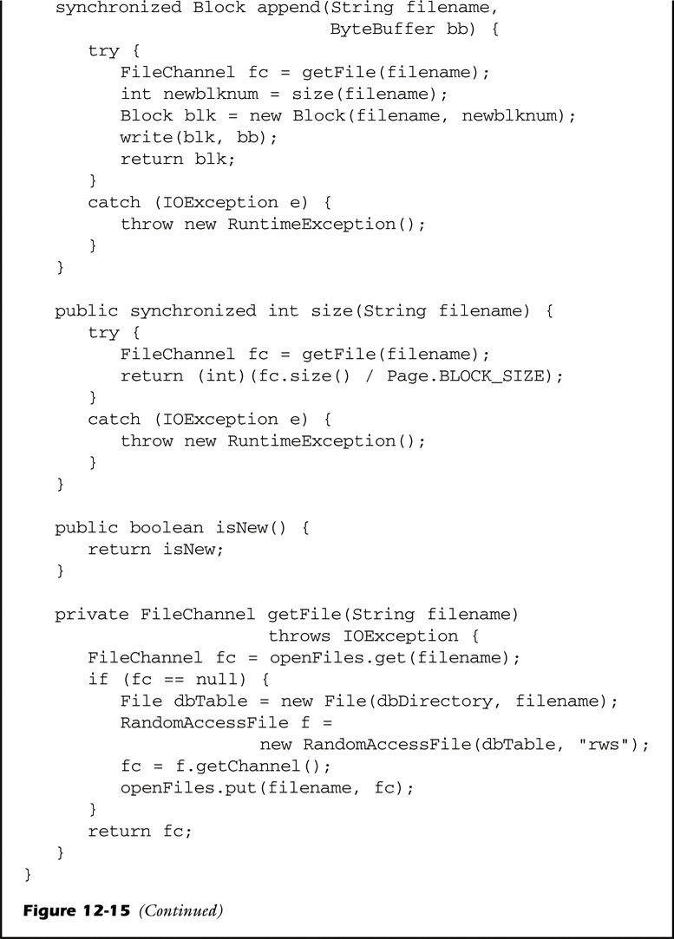
SimpleDB - FileMgr
// return number of blocks

Slide 19
SimpleDB - Page

Slide 20
Memory management
Chapter 13

Slide 21
Objects(목표)
How to efficiently manage the reading and writing of disk blocks with main memory (어떻게 디스크를 메모리와 같이 효율적으로 읽고 쓸 것인가?)
How the SimpleDB reads/writes a block to memory from disks?

Slide 22
Contents
Log Management
SimpleDB Log Manager
Buffer Management
Simple DB Buffer Manager

Slide 23
Fundamental Principles
Minimize disk accesses
Memory is 100,000 times faster than disk
Don’t rely on virtual memory
Because of artificial continuity
Notes:
100,000

Slide 24
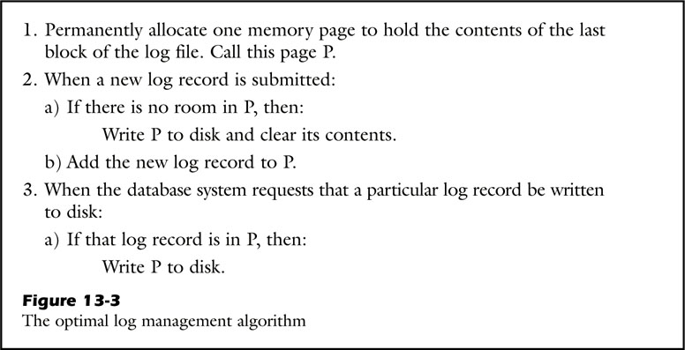
Managing Log Information
Log
The values describing a change.
Log records are stored in log file.
Log Manager
The log manager is the portion of the database system that is responsible for writing log records to the log file.
Managing log algorithm

Slide 25
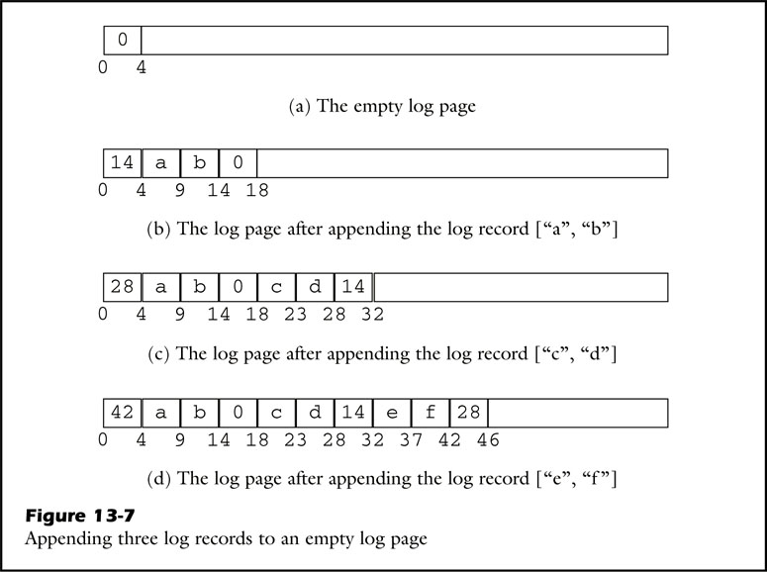
Managing Log Information
Datastructure of log
In SimpleDB, all log records with same log sequence number are in a block.
Last integer of page is a offset of last log.(a
First integer of block is a offset of previous log.
First integer of page is a offset of last log.
Notes:
블락 ,페이지 알려주기
어떤 것이 최신인지 알려주기(previous, last, first)

Slide 26
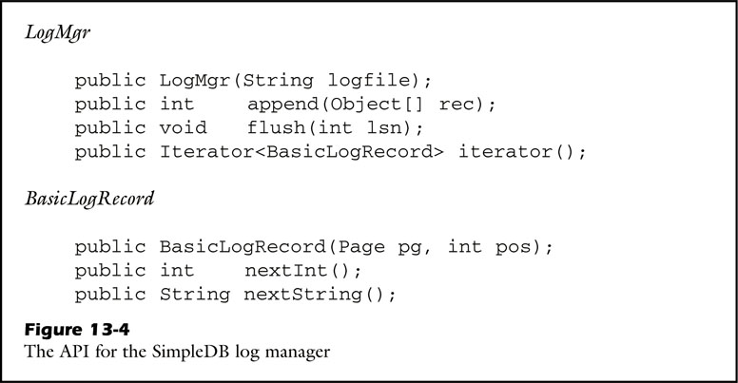
Log Manager - Overview
// based-on log file.
// append log record
// write page to disk if needed
// for log record
// page, current pos
// read int of current pos
// read string of current pos

Slide 27
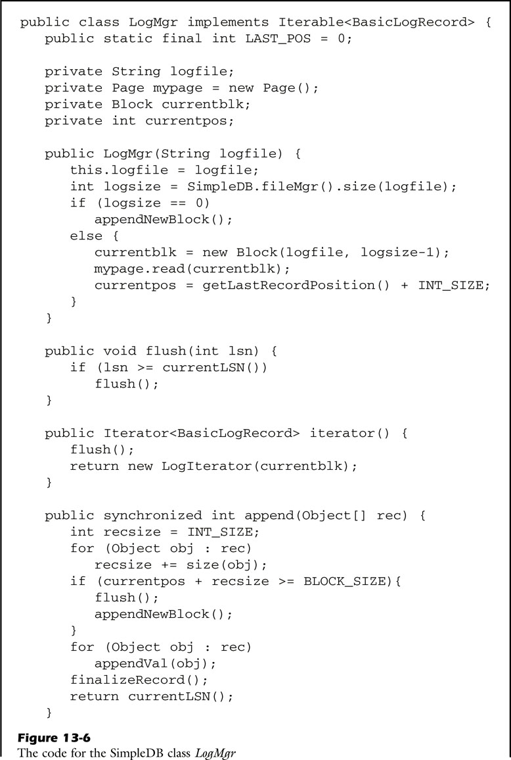
Log Manager – Class LogMgr
// Not use

Slide 28
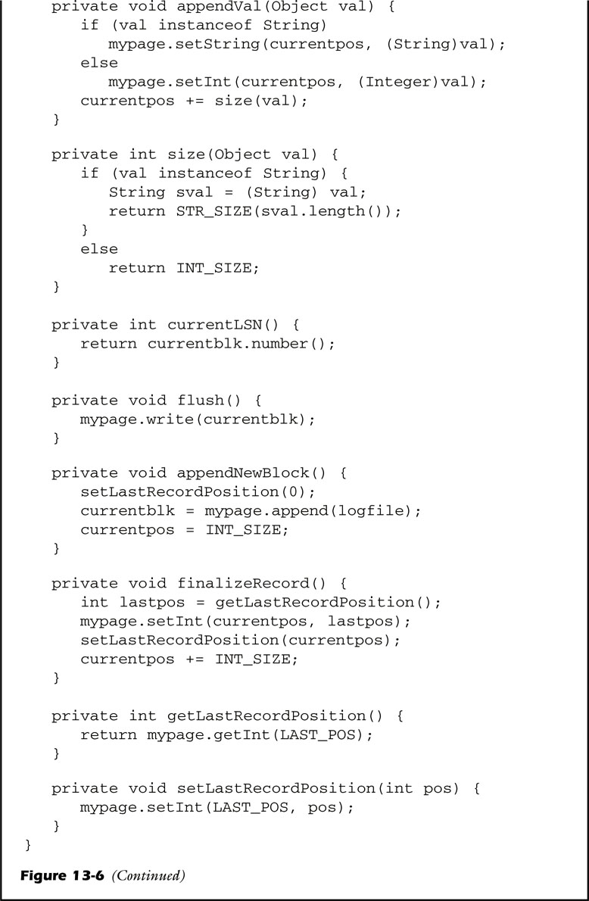
Log Manager – Class LogMgr
Notes:
The method flush compares the current block number against the specified LSN. If the specified LSN is smaller, then the desired log record must have already been written to disk; otherwise, mypage is written to disk.

Slide 29
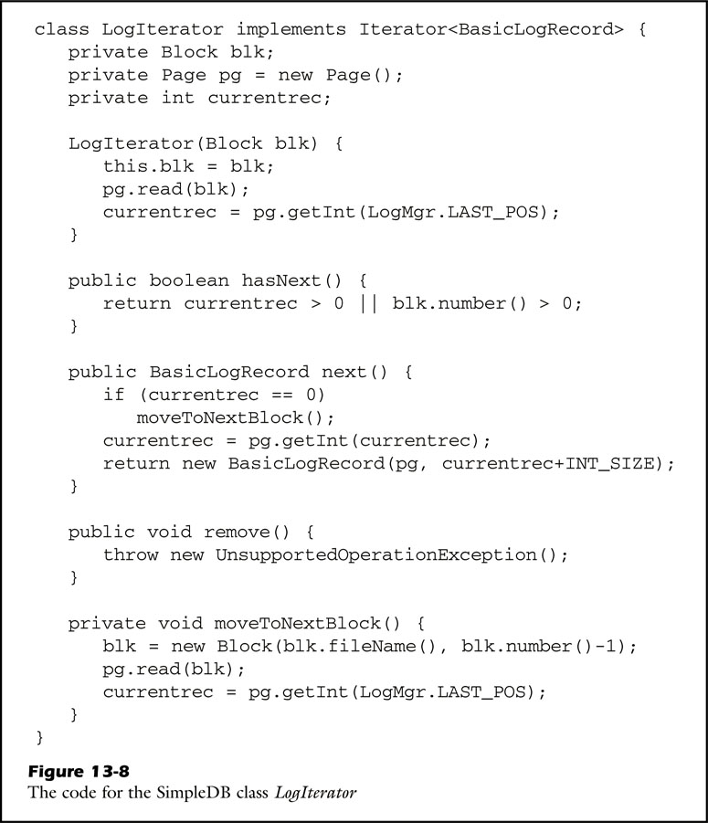
Log Manager – Class LogIterator
How to next can read earlier record?
Current record number &
Offset of earlier record!!
Notes:
The method flush compares the current block number against the specified LSN. If the specified LSN is smaller, then the desired log record must have already been written to disk; otherwise, mypage is written to disk.

Slide 30
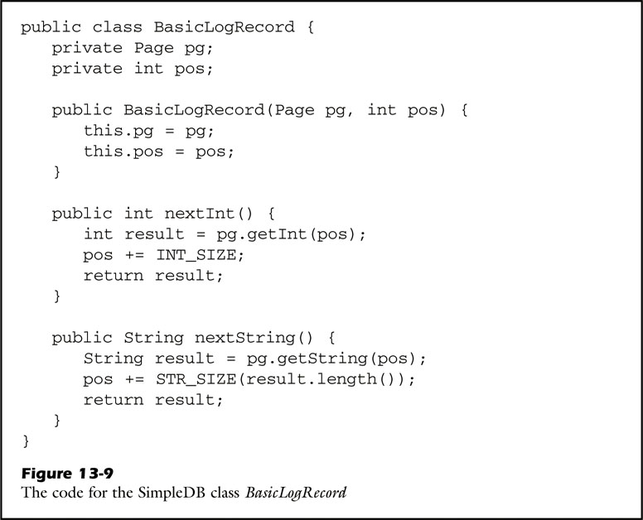
Log Manager – Class BasicLogRecord
Variables
pg is the page containig this record
pos is location of the first value in it

Slide 31
Managing User Data
Buffers
Object that contains associated status information like whether the page is pinned or not. (페이지 사용 여부 같은 정보를 관리하는 객체)
Logical reference to the block assigned to its page(어떤 블록이 어떤 페이지에 할당되었는가)
The number of times the page is pinned(페이지가 pinned 된 횟수)
An integer indicating if the page has been modified(페이지 수정 여부)
Log information(로그 정보)
The Buffer Manager(버퍼 관리자)
The buffer manager is portion of the database system, responsible for the pages that hold user data.(DB 시스템에서 유저 데이터를 가진 페이지를 담당)
Notes:
Nevertheless size of buffer pool is limited, accessing data isn’t predictable.

Slide 32
Managing User Data
Buffer Replacement Strategies(버퍼 교체 정책)
If there is no unallocated buffer, Buffer manager should choose page to be replaced
Naïve : Replace first unpinned page(버퍼 풀 중 가장 첫 번째 unpinned 버퍼를 교체)
FIFO : First In First Out(가장 먼저 들어온 버퍼 교체)
LRU : Least Recently Used(사용된 지 오래된 버퍼 교체)
Clock Strategy : Replace first unpinned page like Naïve, but scan is started from last replaced buffer(마지막에 교체된 버퍼 이후로부터 첫 unpinned 버퍼를 교체)
Notes:
버퍼 매니저가 필요한 이유
버퍼의 교체가 필요한 이유 설명하기

Slide 33
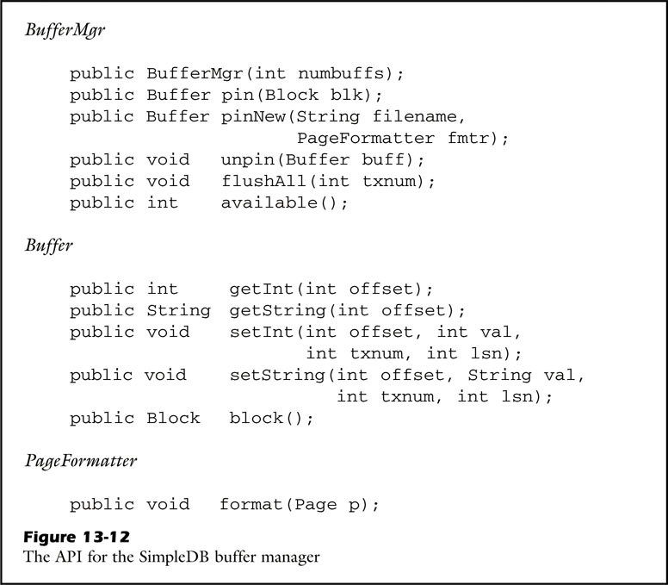
Buffer Manager – Overview
BasicBufferMgr
Manage buffer pool
BufferMgr
Manage waiting list
Difference between basicBufferMgr is “return null if there is no unpinned buffer”
Buffer
Object that has associated infom- ation.
PageFormatter
A tool for create initial page
// write to block
// Return available buffer
// Return assigned block

Slide 34
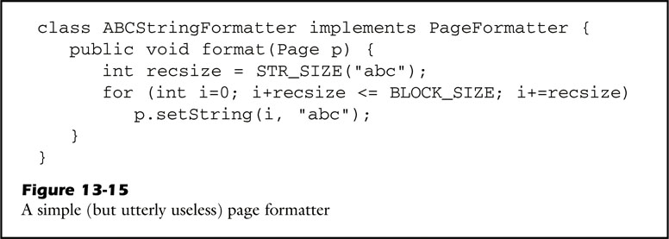
Class PageFormatter
Make initial page from string filename

Slide 35
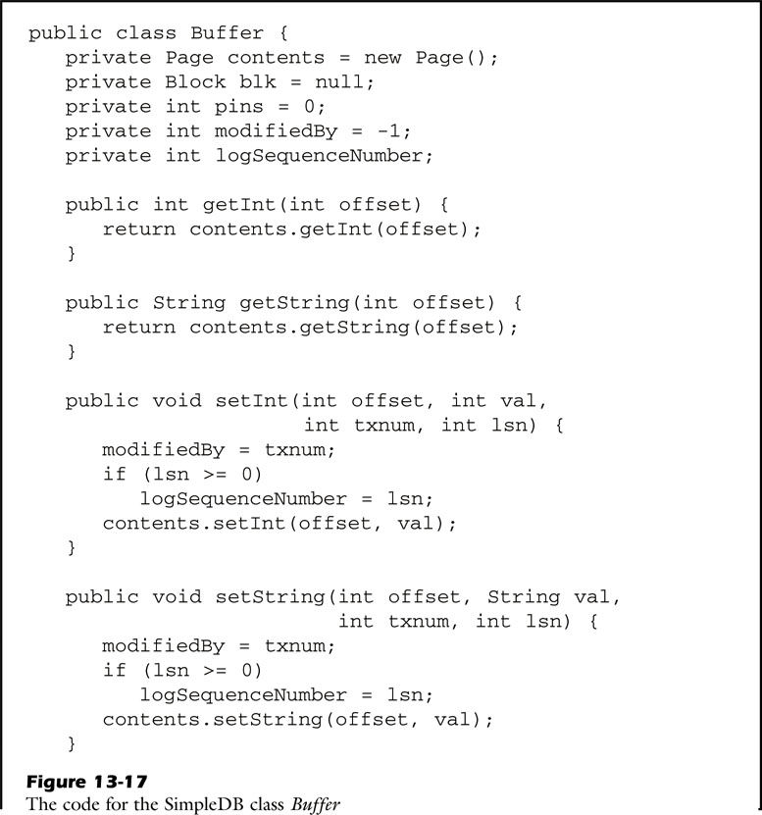
Class Buffer
Variables
Txnum : transaction number
Pins : how many times this buffer pinned?
logSequnceNumber : for logging
modifiedBy : what transaction modified this buffer?

Slide 36
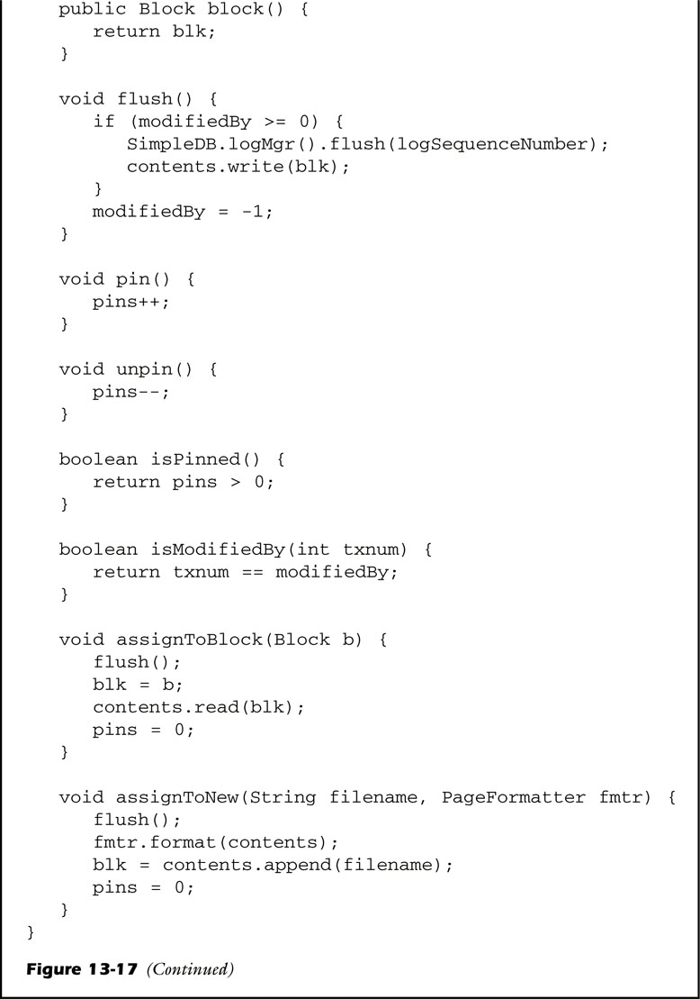
Class Buffer

Slide 37
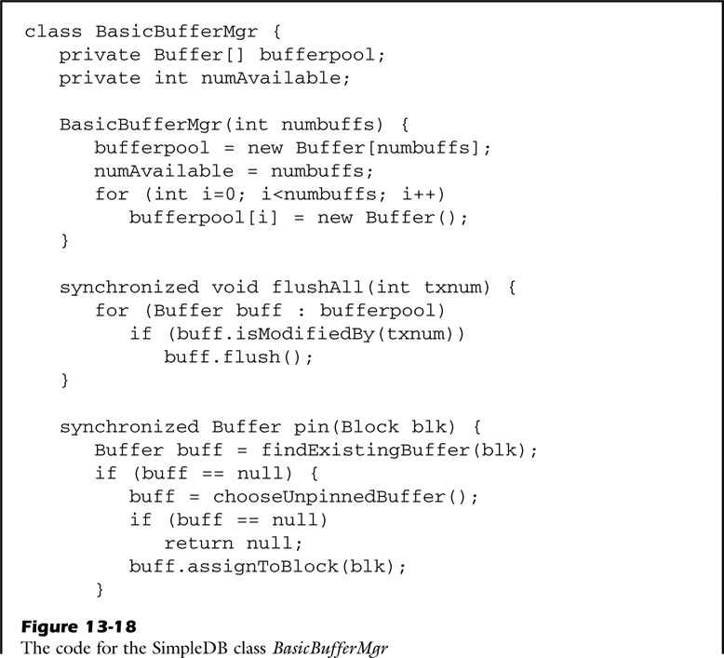
Class BasicBufferMgr

Slide 38
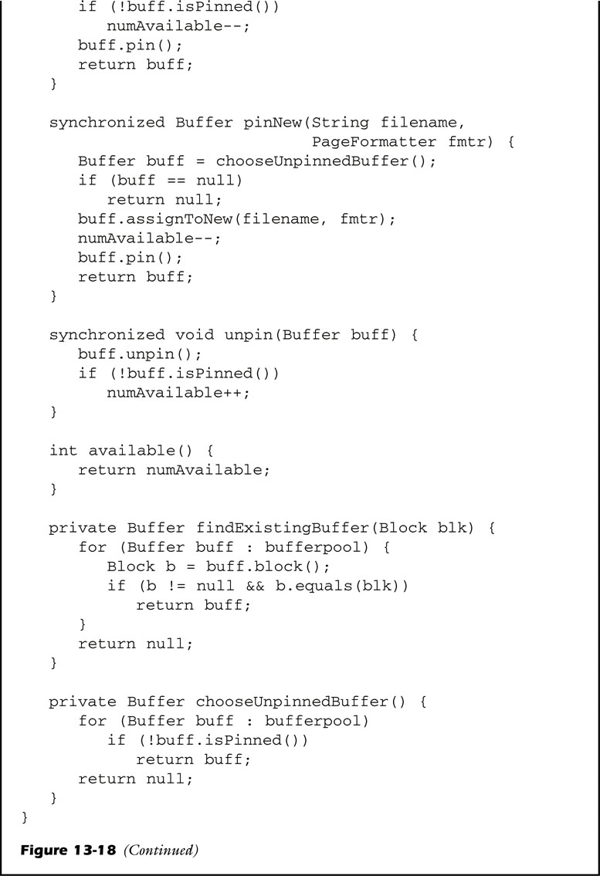
Class BufferMgr

Slide 39
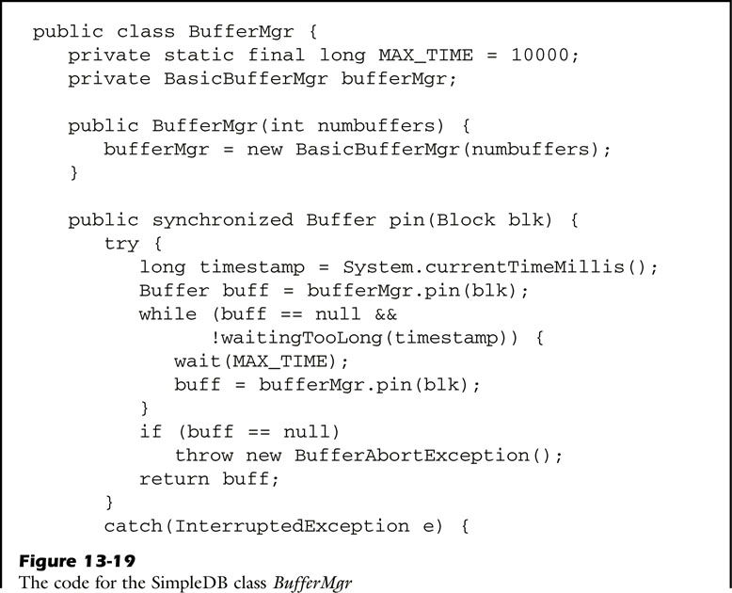
Class BufferMgr

Slide 40
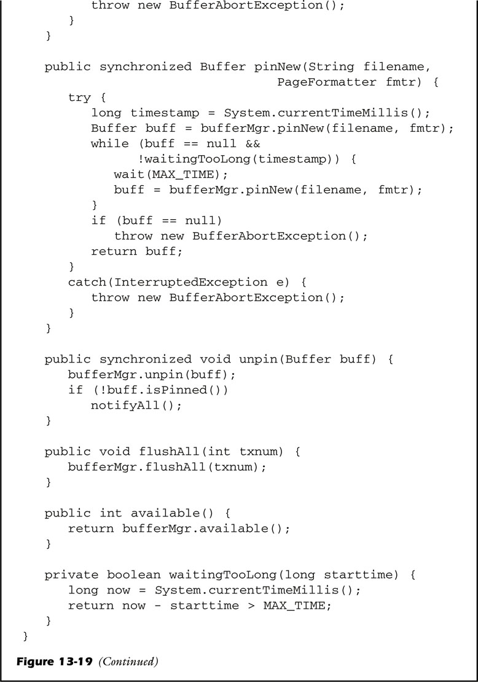
Class BufferMgr

Slide 41
QnA

Slide 42
Class Buffer

Slide 43
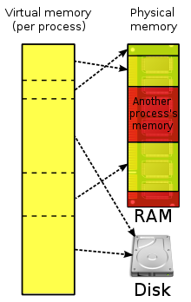
Virtual Memory
It maps memory addresses used by a program, called virtual addresses, into physical addresses in computer memory.
Virtual memory makes application programming easier by hiding fragmentation of physical memory;

Slide 44
Native I/O – ByteBuffer
Methods
Position : current pointer
Limit : implicit available pointer
Capacity : Capacity of buffer, last point of buffer

Slide 45
Native I/O – FileChannel
Use to read/write data in bytebuffer to a file
Example
FileInputStream fis = new FileInputStream("input.txt");
FileOutputStream fos = new FileOutputStream("output.txt");
ByteBuffer buf = ByteBuffer.allocateDirect(10);
FileChannel cin = fis.getChannel();
FileChannel cout = fos.getChannel();
cin.read(buf); // Read from channel(input.txt) to buffer
buf.flip();
cout.write(buf); // write data in buffer to channel(output.txt)

